Slide 1

WELCOME
SYLVAN HILLS MIDDLE
GO TEAM MEETING

Slide 2

Let’s commit to:
Wearing masks and socially distancing
Being present and engaging meaningfully so that we can learn from each other (i.e. Cameras on)
Refrain from using electronic devices unless required to engage in the work
Muting your microphone (VIRTUAL) and minimizing extraneous conversations
Assuming good will
Allowing all voices of the team to be heard
Focusing on the day’s content
Starting and ending on time
Being gracious

Slide 3

Today’s Agenda
Call to Order
Review GO Team Norms
Roll Call
Action Items
  Approval of Agenda
  Review of Previous Meeting Minutes
Information Items
  Principal’s Report
Announcements
Public Comment
Adjournment

Slide 4
GO TEAM MEMBERS 20-21
NAME | ROLE
Ms. Monica Blasingame | Principal
Ms. Jessica Bracey | Parent
Ms. Queen Rosa Harden-Green | Parent
Mr. Mark Gresham | Parent
Ms. Sade Miller | Staff
Mr. Derwin Purnell | Staff
Ms. Sonjyia Bryant | Staff
Ms. Keisha Mackey | Community Member
LaSandra Brown | Community Member
Ms. Johna Rhooms | Swing Seat

Slide 5

Action Items
.
Action Items
  Approval of Agenda
  Approval of Previous Minutes

Slide 6
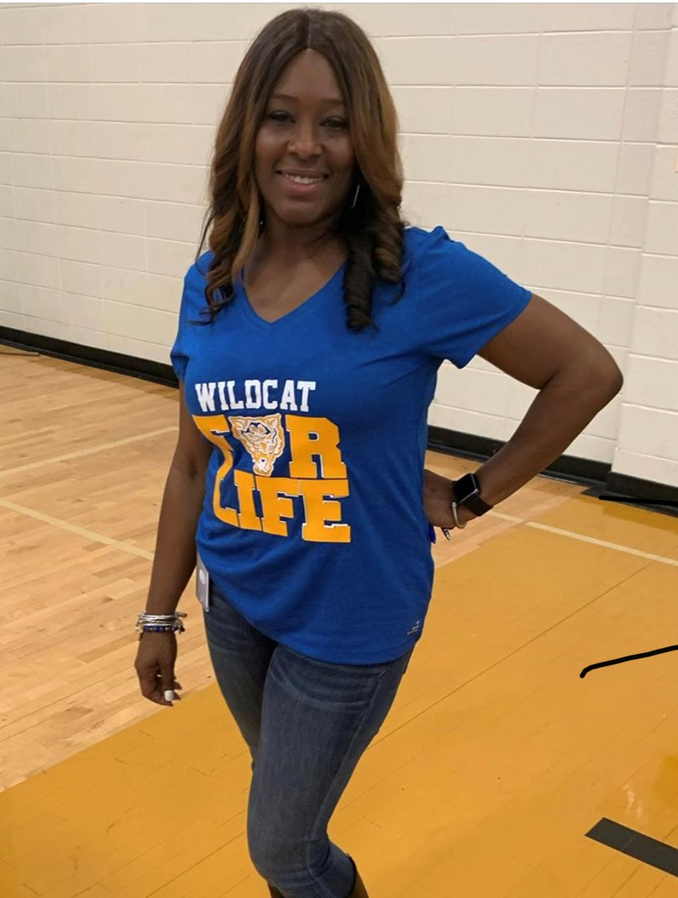
PRINCIPAL’S REPORT
Budget Update
Beyond the Day Intervention Program
We are preparing to celebrate:
College & Career Readiness Week

Slide 7




Sylvan Hills Middle (Carver Cluster)
District Mission & Vision
Cluster Mission & Vision
School Mission & Vision
With a caring culture of trust and collaboration, every student will graduate ready for
college and career.
A high-performing school district where students love to learn, educators inspire, families engage and the community trusts the system
Through a culture of collaboration, respect, and trust, the Carver Cluster will enhance and strengthen its overall academic programs while maintaining a sage and nurturing environment that prepares students for college and careers.
The Carver Cluster will produce high-performing, college and career ready students that are globally aware and ready to have a positive impact on society.
It is our mission to provide a learning environment that ensures high expectations for all of our scholars through quality instruction, real-world applications and technology that promotes and fosters knowledge and skills.
Sylvan Hills Middle School will provide a nurturing and safe environment where scholars become critical thinkers, problem solvers, lifelong learners, and productive citizens.
Signature Program: College And Career Prep
School Priorities
School Strategies
Key Performance
Measures
Cultivate a literate community in which students read and write with clarity and fluency across all contents
Improve students’ mathematics performance
Improve students’ enrollment and success in higher-level classes
1A. Develop, implement and monitor best writing practices across all contents. 1B.Implement a meaningful literacy/math block (SFA) that includes whole group instruction, flexible small group instruction and literacy work stations.
1C. Develop and implement a Response to Intervention (RTI) plan, beginning with strong first teaching and targeted intervention.
1D. Implement Definitions of Teaching Excellence
2A-E. Same as 1B-1F
2F. Implement weekly common assessments
2G. Focus on unit assessment performance
3A. Develop master schedule aligned with student data, needs, and high school course offerings
3B. Offer more courses that will earn high school credits
Increase students performance on GA Milestones in Reading, Writing, and Math.
Increase student performance on STAR Assessment.
Increase students performance on 4sight reading assessment (quarterly).
Improve performance on district benchmark assessment
Improve NAEP scores (8th grade only)
Increase the number of parents and community members that participate in local and state administered surveys.
Increase TKES evaluation scores
Increase overall CCRPI rating
Improve students’ attendance
Improve culture and climate ratings
Academic
Program
Foster a culture of ongoing support for teacher development.
Recruit and maintain highly talented faculty/staff trained in researched-based best for developing the total middle school student (academically, socially, and emotionally)
4A. Identify teacher growth opportunities to provide ongoing coaching support.
Communicate clear expectations and feedback to teachers.
4B. Consistently implement revised teacher induction program for staff new to Sylvan.
4C. Provide ongoing valuable staff development designed to help staff elevate the rigor in the classroom and help students utilize higher order thinking, reading and writing skills.
5A. Establish and maintain incentive program to reward faculty and staff who consistently demonstrate the highest standards of professionalism.
Talent
Management
Engage all facets of the community as partners and align people and resource to maximize impact.
6A. Build relationships between school leadership/staff and partner leadership in order to better serve the needs of the Sylvan Hills community.
6B. Strengthen family and community support to increase parent involvement.
6C. Establish and maintain communication with the community about formal and diverse engagement opportunities at Sylvan Hills.
6D. Offer ongoing surveys to students, staff, and parents to determine needs and current awareness of existing programs and community resources.
Systems &
Resources
Provide increased teaching and learning opportunities for all staff and students.
7A. Implement Social Emotional Learning (SEL) daily.
7B. Utilize the services of the Northstar Psychological Services and other providers to assist students/families.
7C. Create a culture to support and encourage our students to behave in a positive manner where they all can learn and feel protected in a safe and orderly environment
Culture

Slide 8



Slide 9

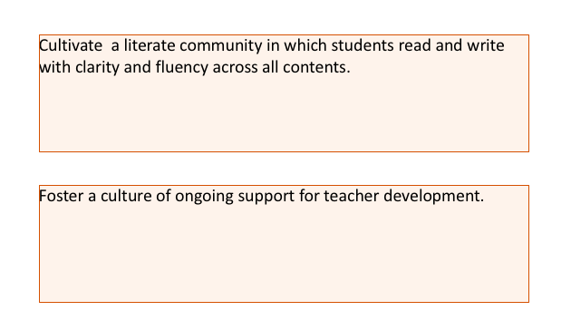
SCHOOL PRIORITIES
2020-2021
SCHOOL PRIORITIES

Slide 10
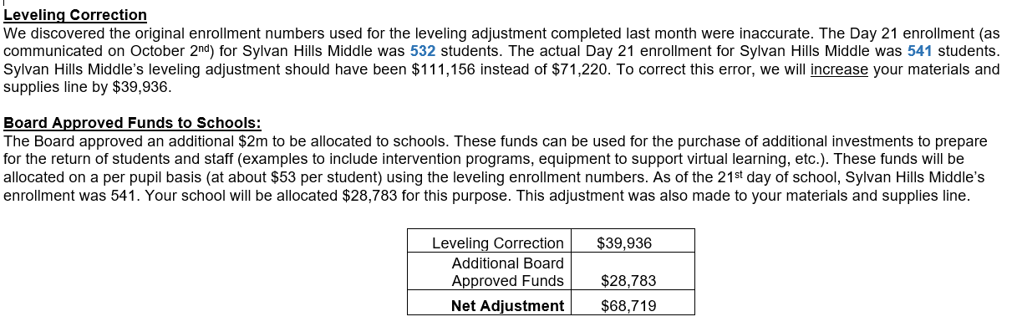
November Budget Adjustments

Slide 11

SHMS Targeted Intervention Program
Principal Monica Blasingame
Ms. Natasha Jewell, Program Coordinator

Slide 12
What is “Beyond the Day?”
SHMS will offer Face to Face Instruction for our students who have the highest needs.
Today we will discuss:
Program Details
Student Criteria & Selection Process
Health and Safety Guidelines
Next Steps

Slide 13
Sylvan’s Plan of Action
Category | Intervention Description | # Of Students Targeted per session | Day & Time | Staff Lead
Academic Intervention | Students will receive support to strengthen skills in literacy in mathematics. | 84 students (Based on the number of Staff members who volunteered- 12) | Tues/Thurs 4:00pm- 5:30pm | Linda Williams
Wellness Interventions | Students will receive social and emotional support. | 7 students | Tues/Thurs 4:00pm- 5:30pm | Natasha Jewell
Engagement Interventions | Students will support with technology and staff will work to remove barriers to engagement. | 7 students | Tues/Thurs 4:00pm- 5:30pm | Derwin Purnell

Slide 14
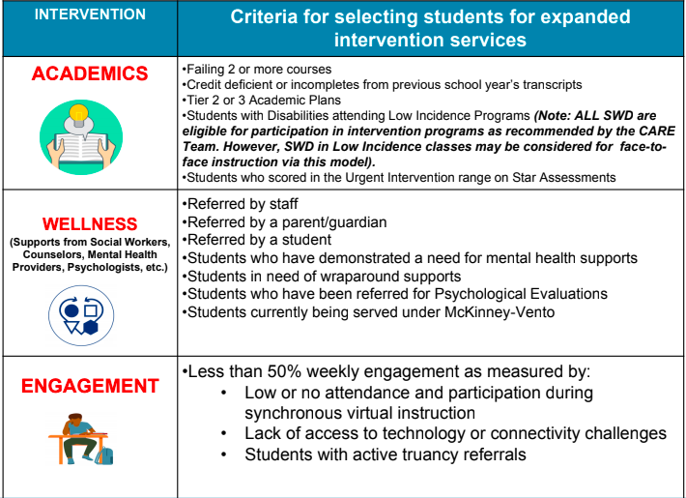
How were students selected?

Slide 15
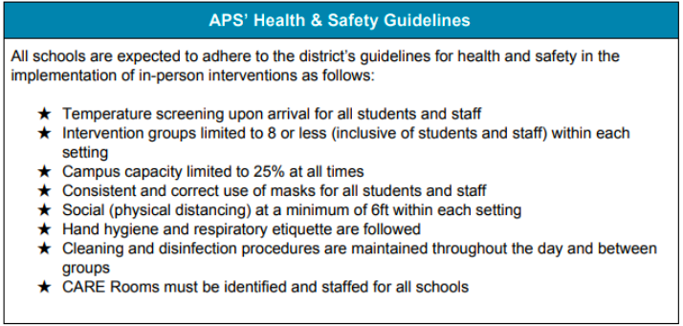

Hospitality Suite

Slide 16
Next Steps:
TASK | Person(s) Responsible | Due:
Submit Names for Recommended students | Teachers | Friday, Nov. 6th
Calls to recommended students | Front Office Staff | Monday, Nov. 9th
Request for meals | Dr. Cotton | Monday, Nov. 9th
Submit Transportation Requests | Ms. Jewell | TBD
Set up Classrooms for Face to Face Instruction | Teachers | Saturday, Nov. 14th
Town Hall for Selected Students | Ms. Jewell | TBD

Slide 17

Announcements
Public Comment
Adjournment

